Slide 1
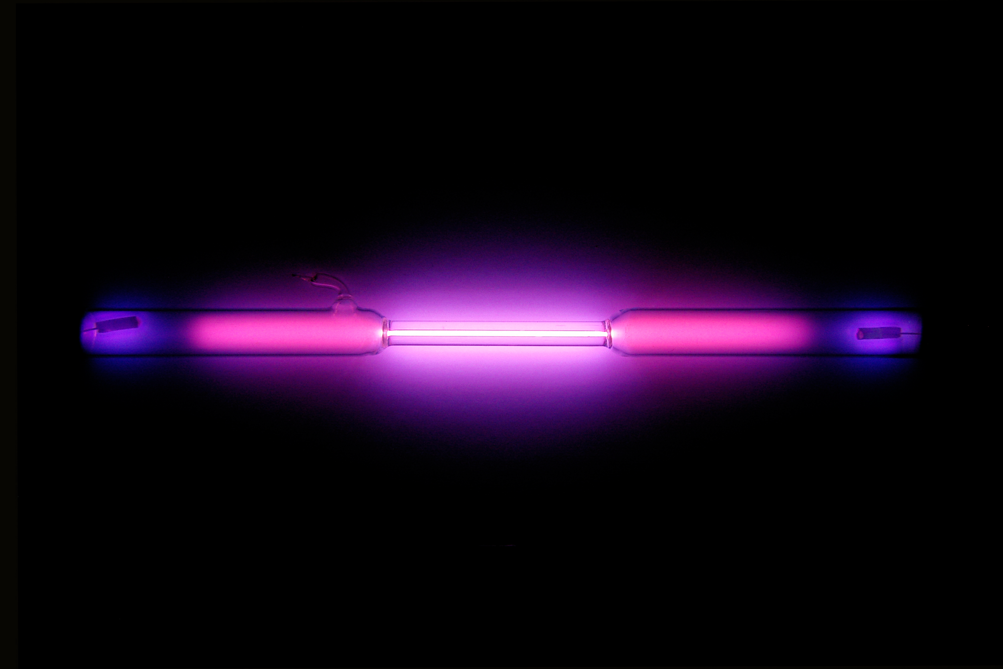
Phase Transitions of Argon
Argon Wikipedia

Slide 2
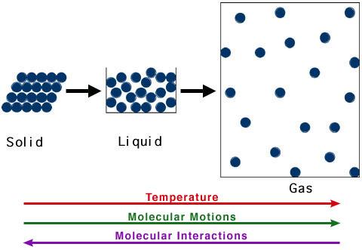
Core Concept
Simulate phase transition of substance
Observe potential energy changes
R. Casiday and R. Frey, Washington University

Slide 3
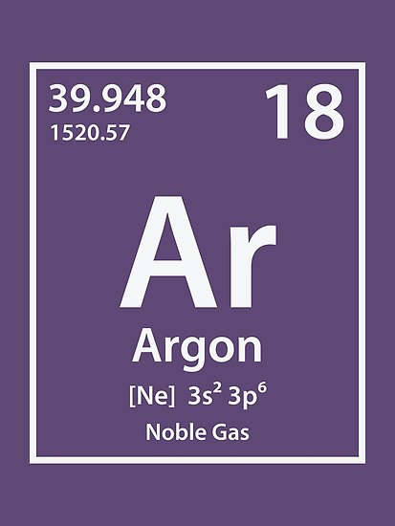
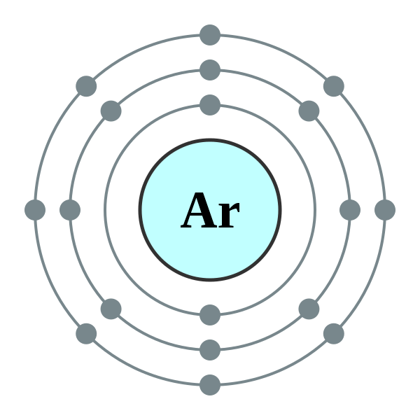
Argon
Noble gas → inert
Does not react
Monoatomic in all phases
Simple Force-Field
apolar
https://id.wikipedia.org/wiki/Berkas:Electron_shell_018_Argon_-_no_label.svg

Slide 4
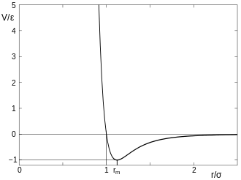
Strong repulsive
force
attraction
Force-Field
Pauli-Repulsion
Prevents overlapping
London-Dispersion
Induced dipol-dipol interaction
→ Lennard-Jones Potential
Lennard-Jones Potential

Slide 5
Force-Field
Pauli-Repulsion
Prevents overlapping
London-Dispersion
Induced dipol-dipol interaction
→ Lennard-Jones Potential
Lennard-Jones Potential

